Slide 1
Final Project PBKK
Bromo Adventure 2022
PBKK B - Kelompok 1

Slide 2
Kelompok 1
Florentino Benedictus 5025201222
Fian Awamiry Maulana 5025201035
Erza Janitradevi Nadine 05111940000153

Slide 3
01
TAMPILAN WEBSITE

Slide 4
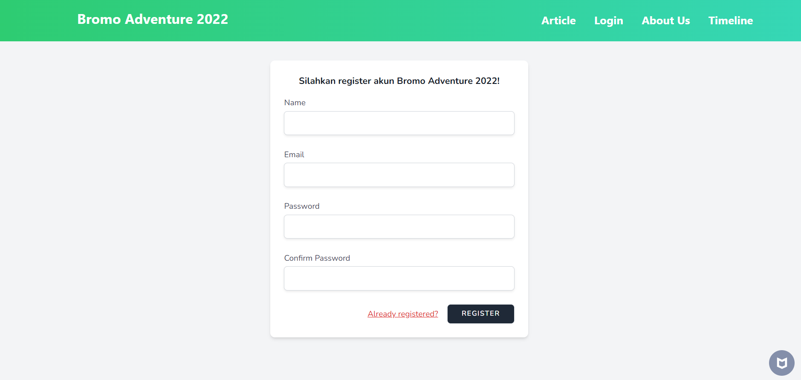
REGISTER

Slide 5
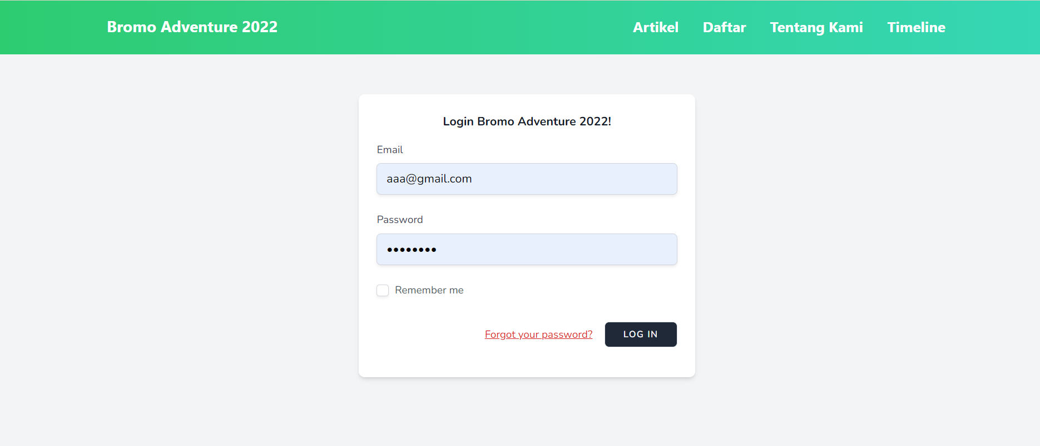
LOGIN

Slide 6
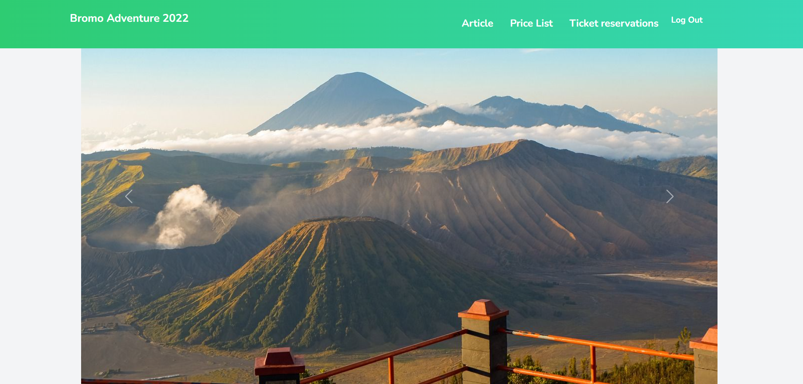
DASHBOARD

Slide 7
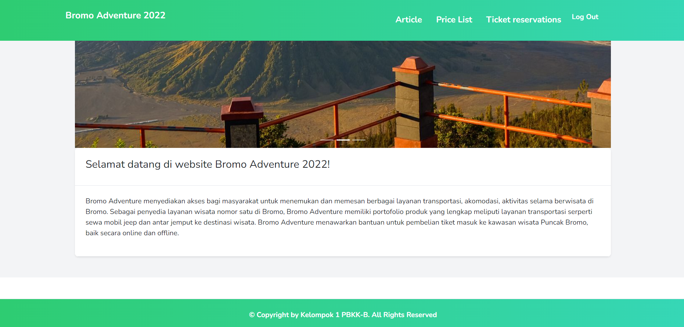
DASHBOARD

Slide 8
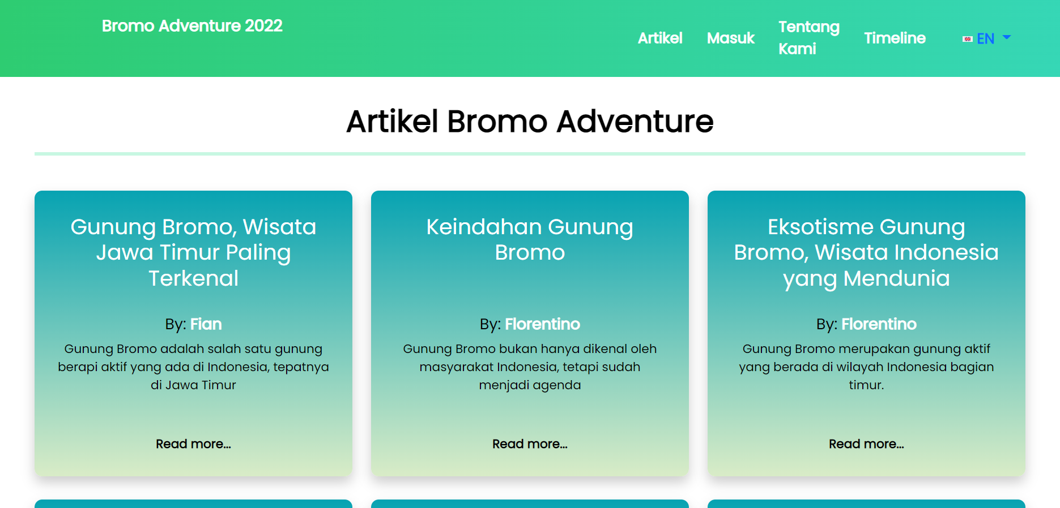
ARTIKEL (ind)

Slide 9
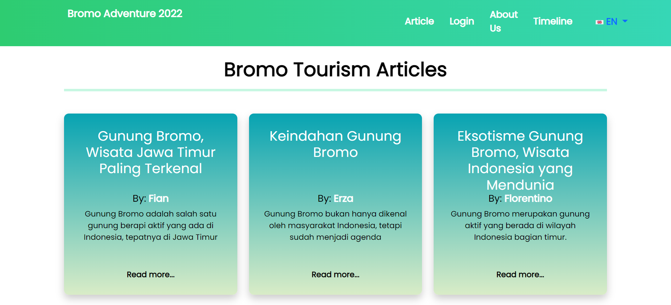
ARTIKEL (en)

Slide 10
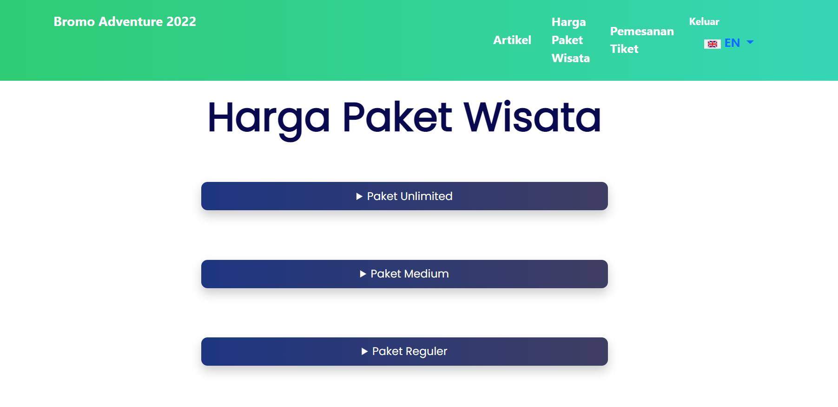
PRICE LIST

Slide 11
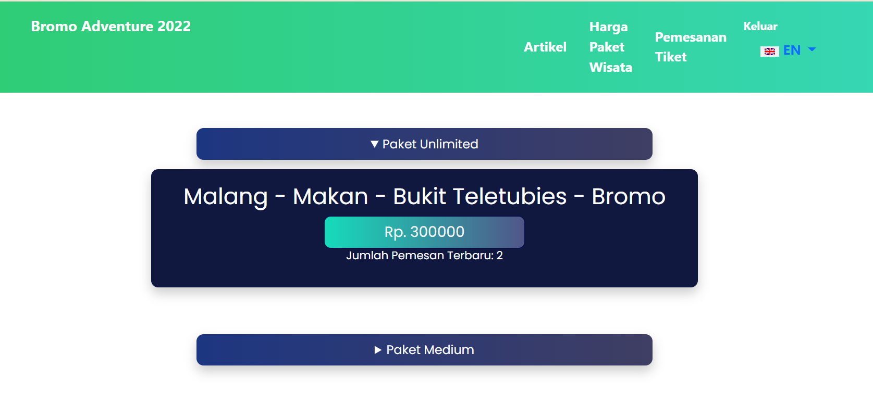
Penggunaan Cache pada Price List

Slide 12
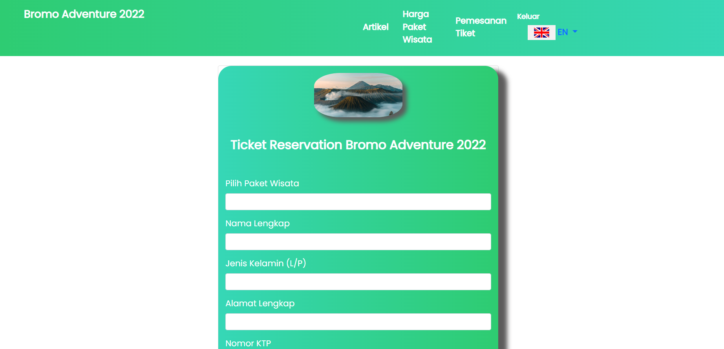
TICKET RESERVATIONS

Slide 13
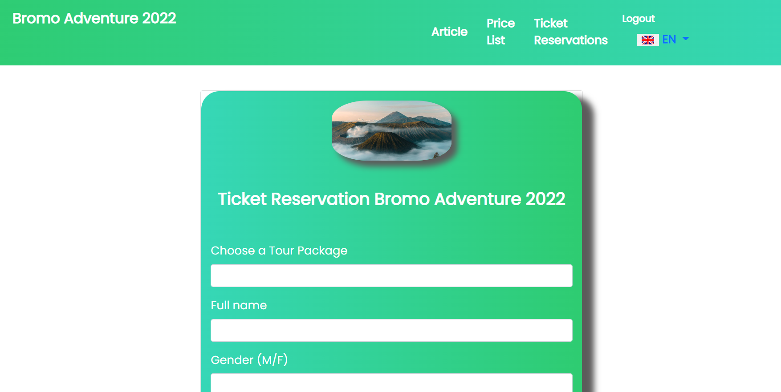
Penggunaan Localizations pada Ticket Reservation

Slide 14
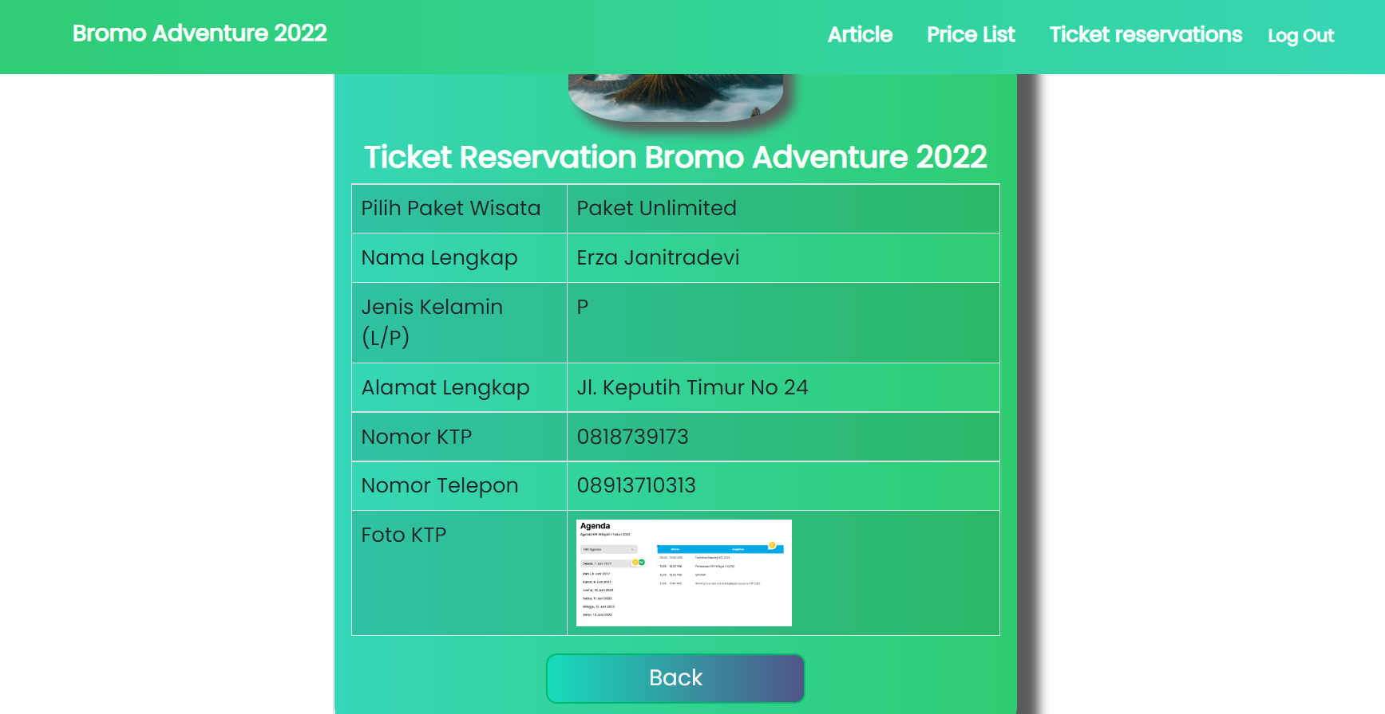
BUKTI PEMESANAN TIKET

Slide 15
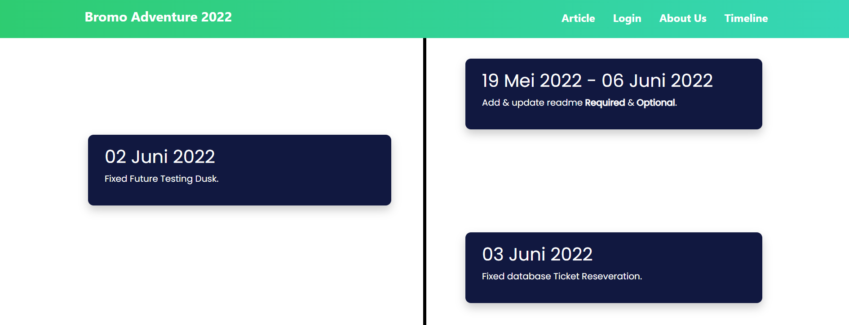
TIMELINE

Slide 16
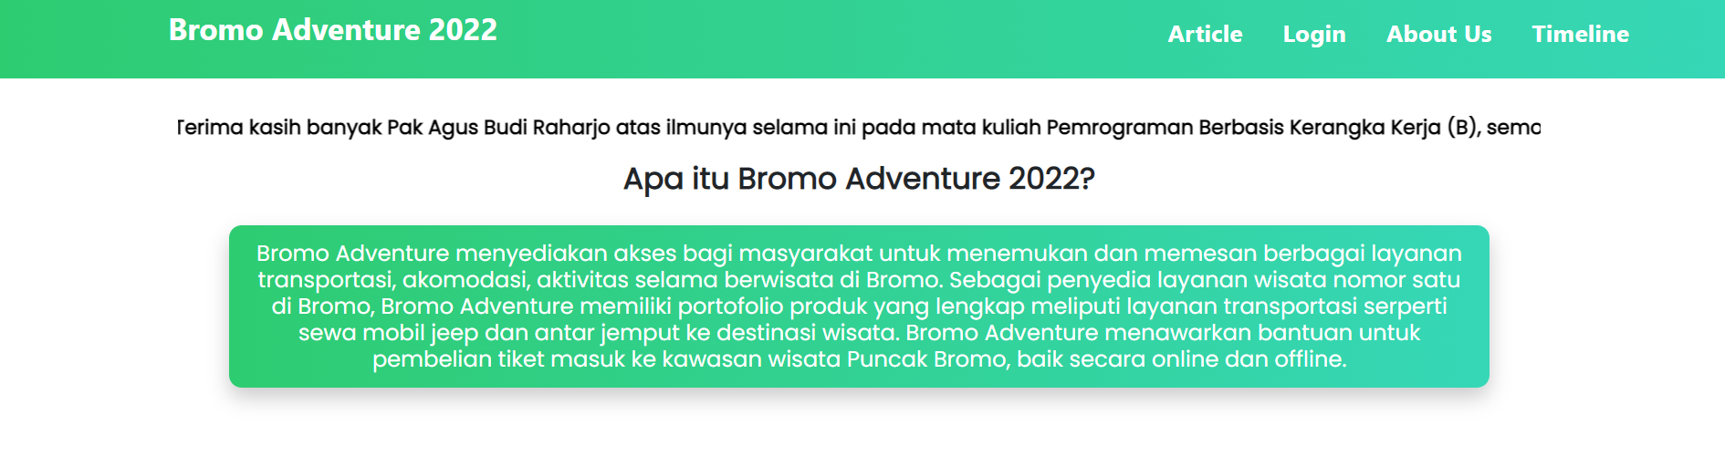
ABOUT US

Slide 17
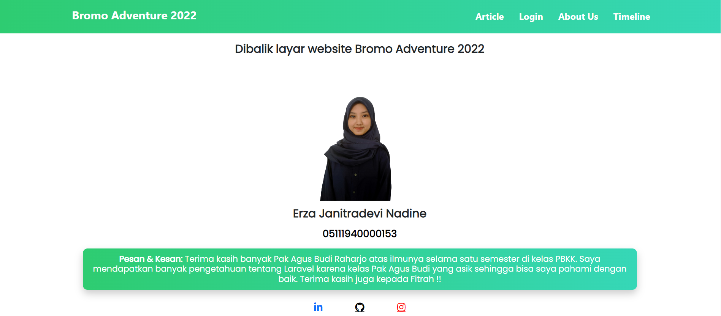
ABOUT US

Slide 18
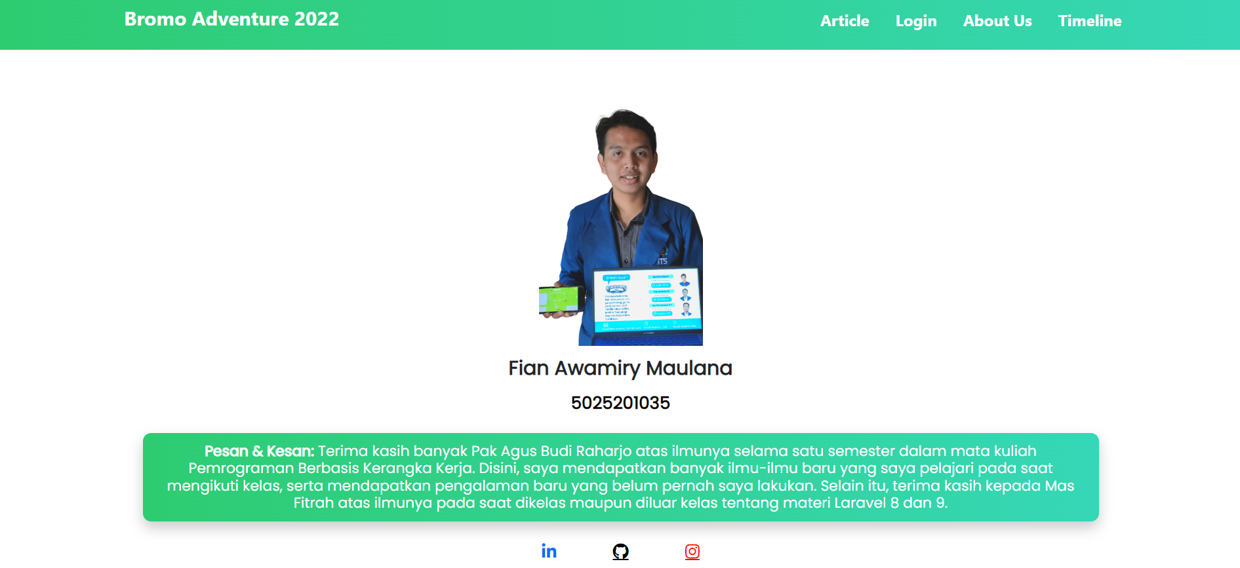
ABOUT US

Slide 19
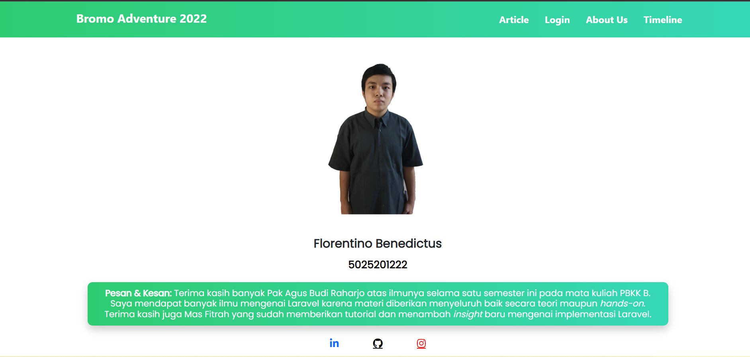
ABOUT US

Slide 20
02
DATABASE

Slide 21
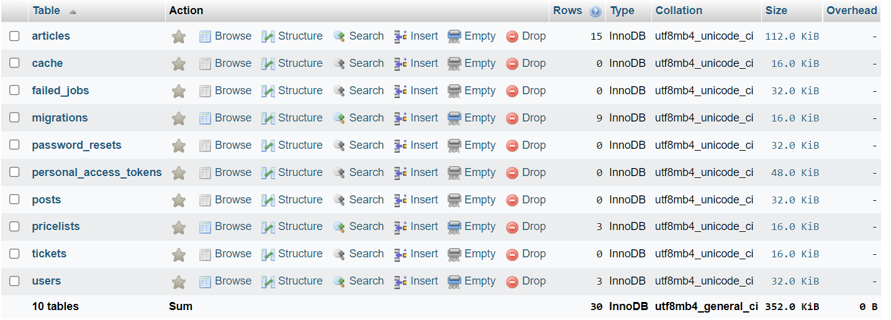
MIGRATIONS

Slide 22
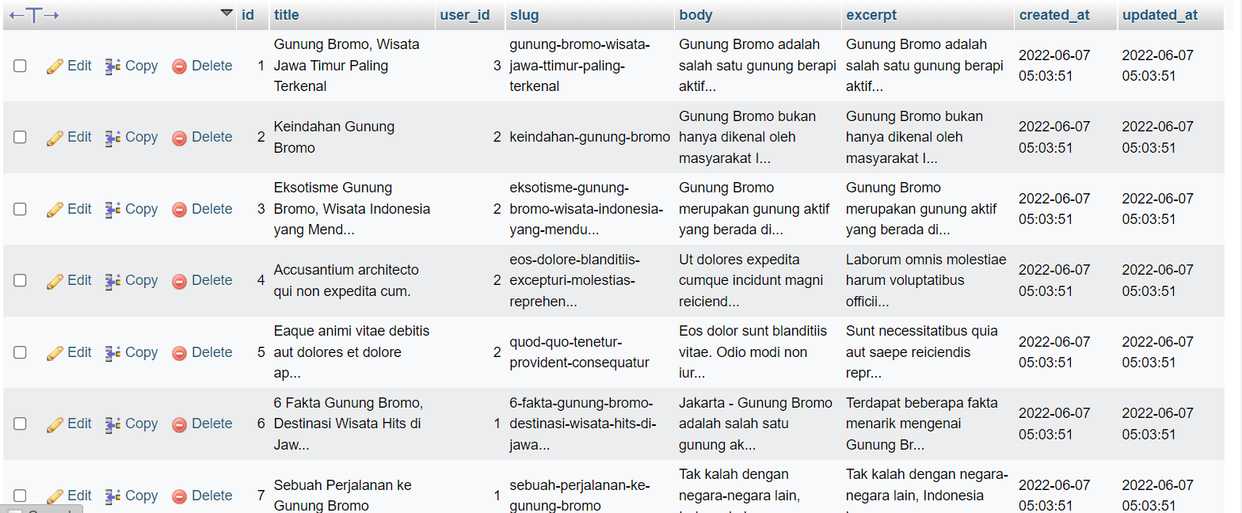
TABEL ARTICLES

Slide 23
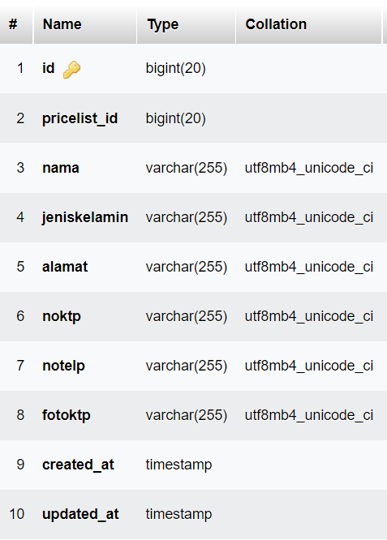
TABEL TICKETS

Slide 24
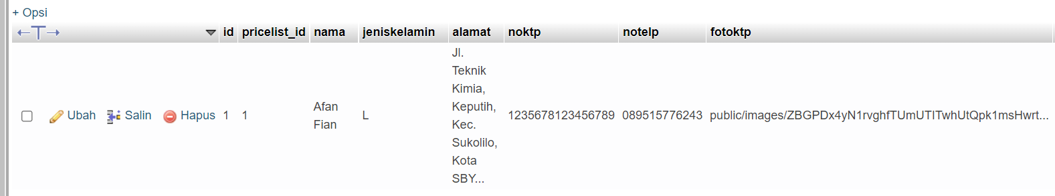
TABEL TICKET

Slide 25
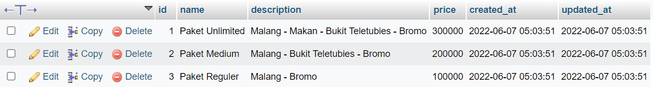
TABEL PRICE LIST

Slide 26
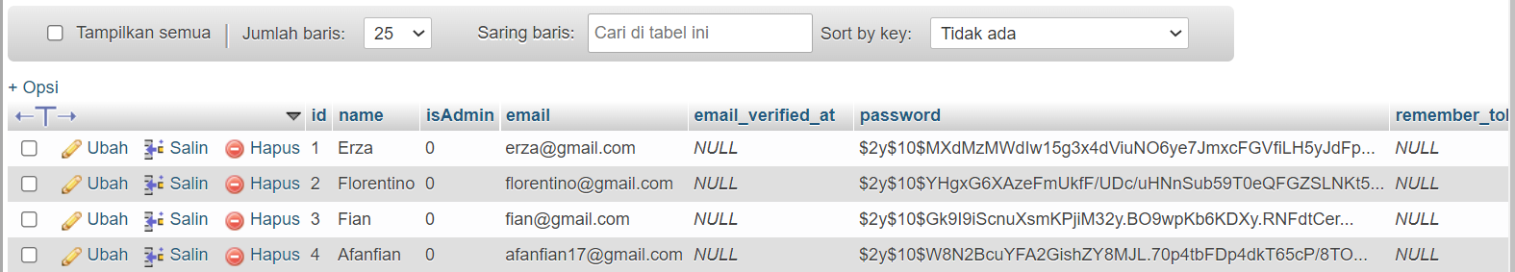
TABEL USER

Slide 27
02
TESTING

Slide 28
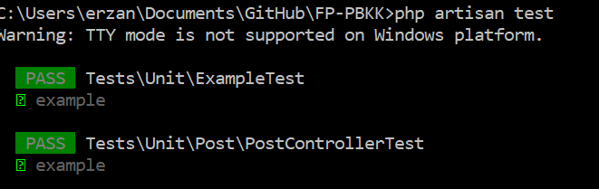
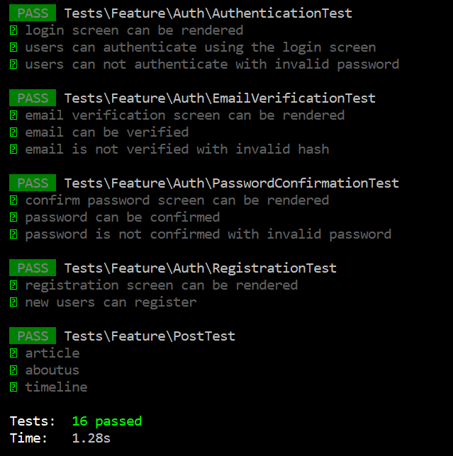
UNIT TESTING

Slide 29
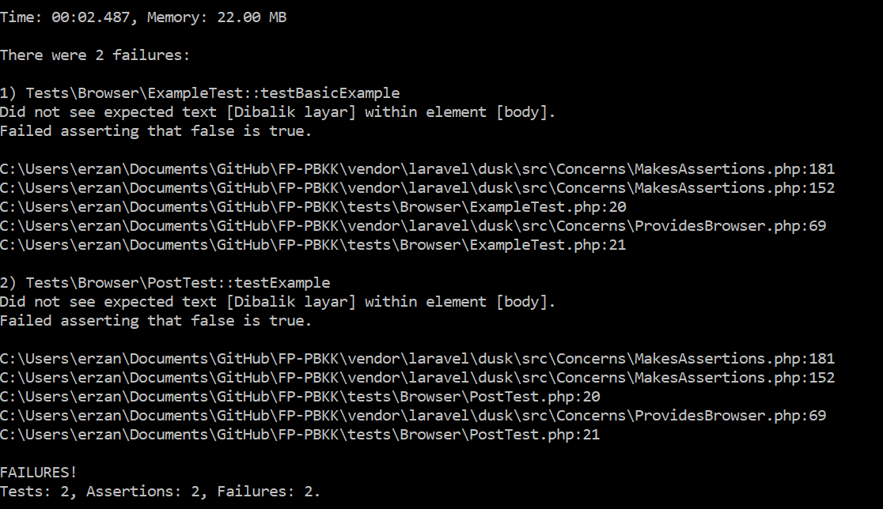
FEATURE TESTING

Slide 30
TERIMA KASIH

